Slide 1


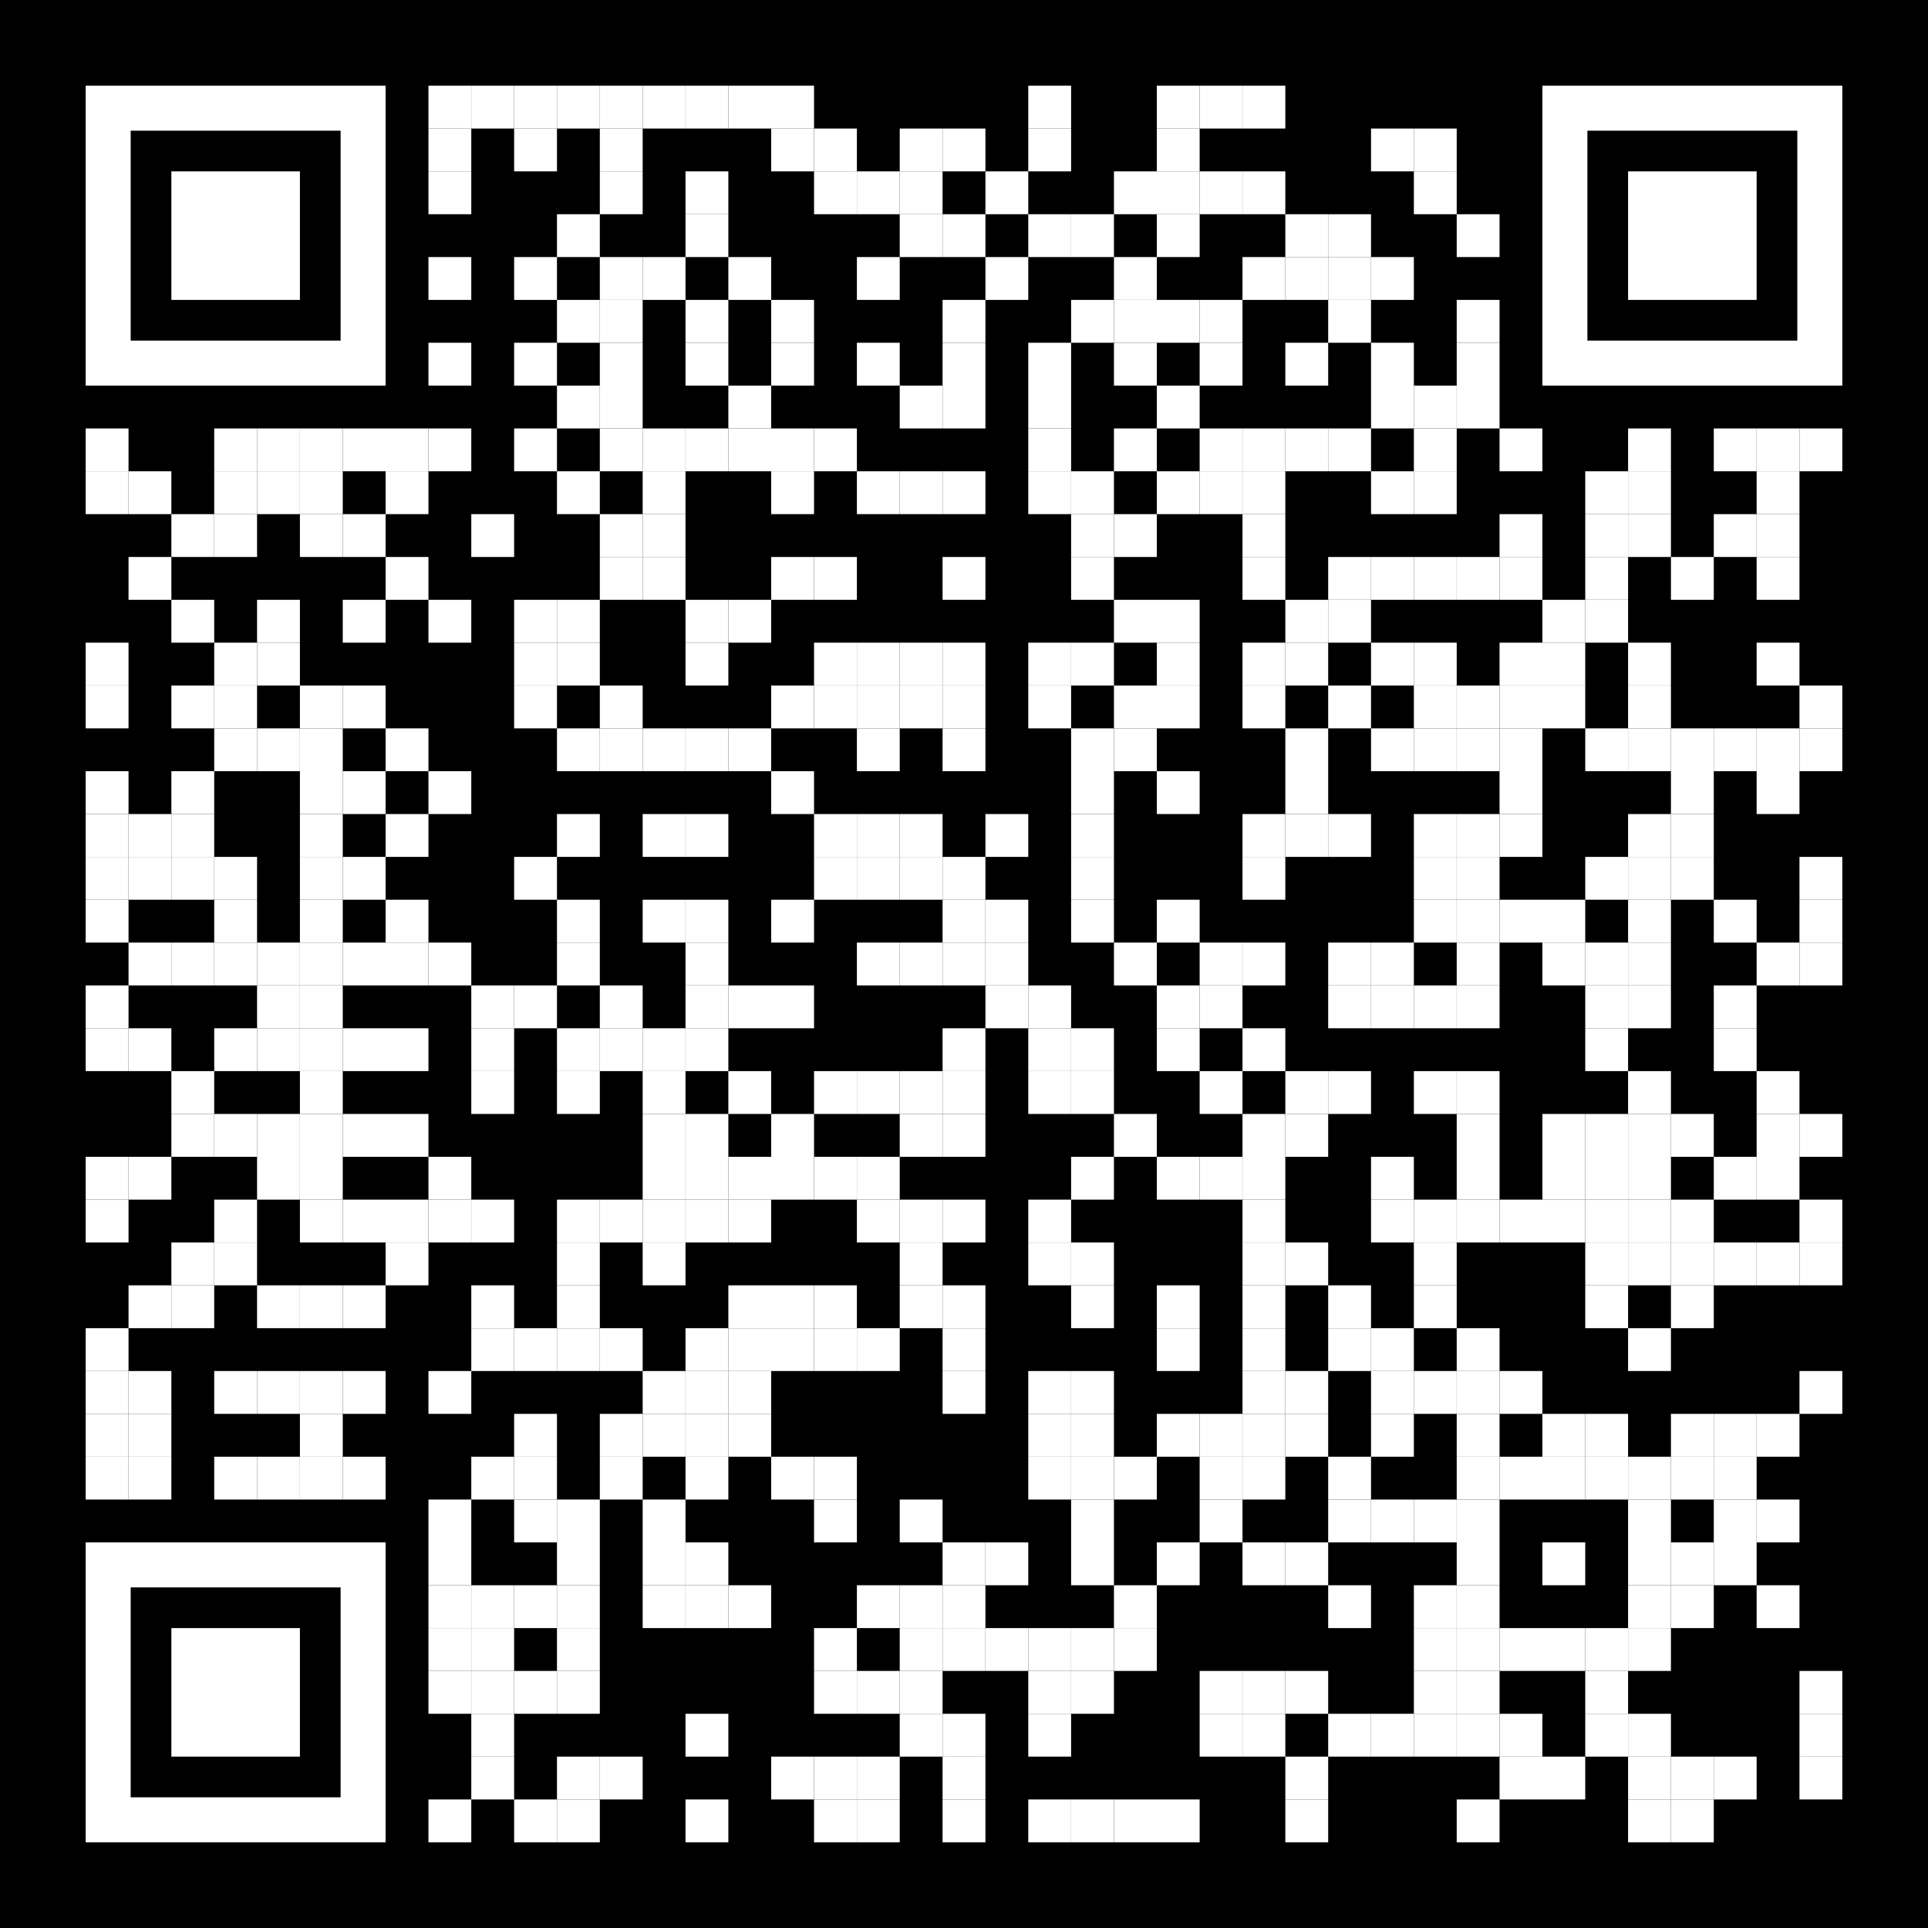
COMPLETE A FIRST-YEAR MILESTONE
& SCAN TO CHART YOUR PROGRESS
Navigate your first-year at owu.edu/passport

Slide 2
TYPE NAME OF MILESTONE RIGHT HERE
Navigate your first-year at owu.edu/passport

